Slide 1
Final Year Project: Week 9 of 20
Marij Qureshi 16th Jan 2020
Robust Optimisation of Composite Panels

Slide 2
Progress
Disruptions due to coronavirus
Model last week – confident in simulation
Design study now – moving to robust
Mesh convergence
Surrogate Model Comparison
Isight workflow
Tuning

Slide 3
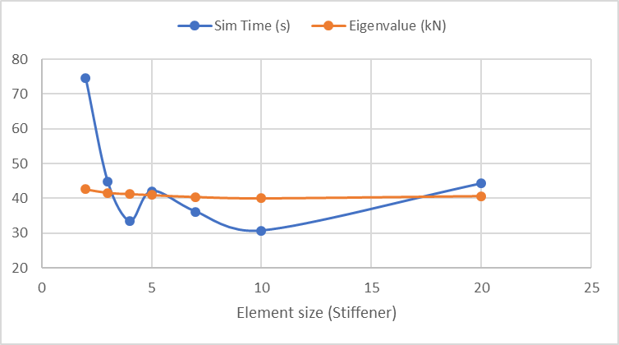
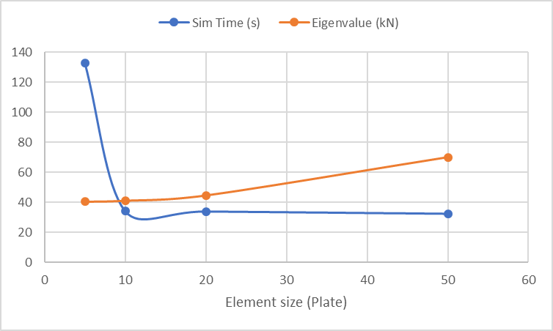
Mesh convergence
Stiffener
Plate
Final element sizes: 4mm (stiffener), 10mm (plate)
Simulation time: ~3 mins to 35 seconds

Slide 4
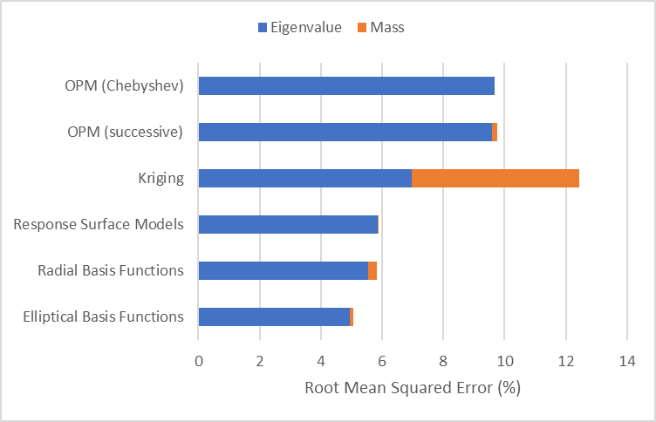
Surrogate Model Comparison
50 Abaqus simulation points
Optimal Latin Hypercube
Elliptical Basis Functions
5% Error
Runtime ~30 mins
Room to increase accuracy

Slide 5
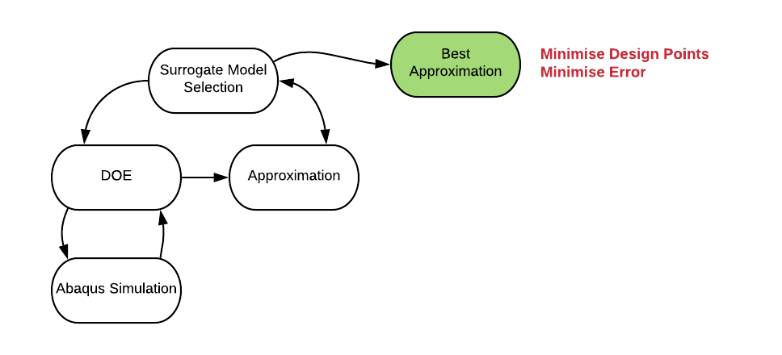
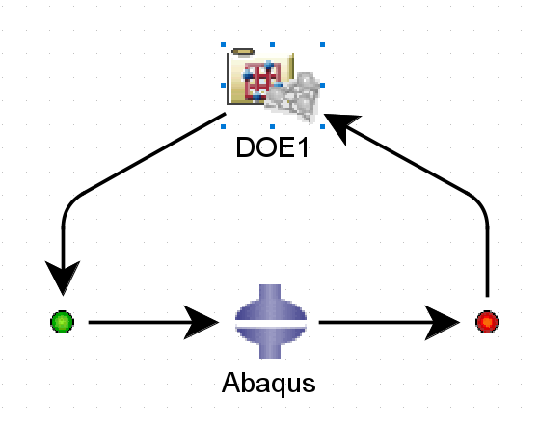
Isight Workflow (Simulation Phase)

Slide 6
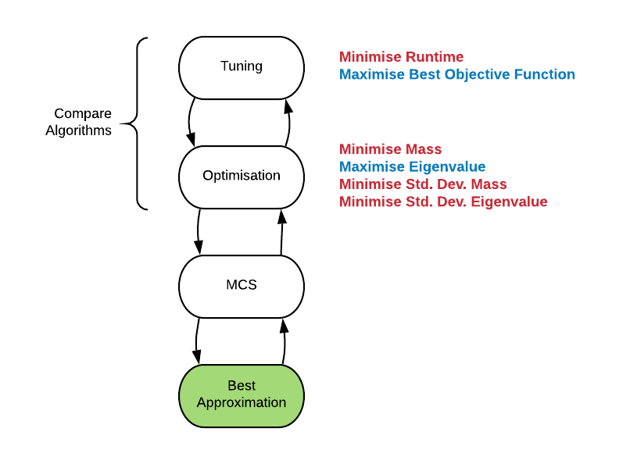
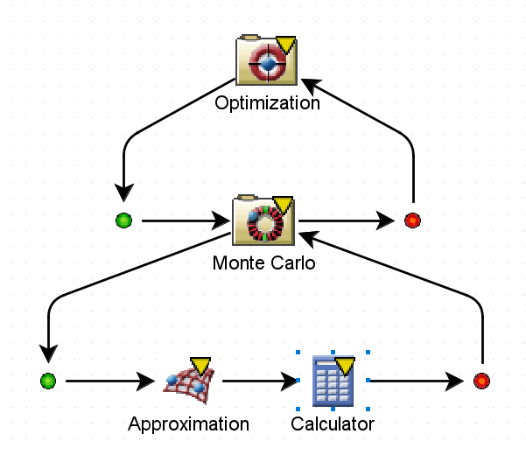
Isight Workflow (Design Study Phase)

Slide 7
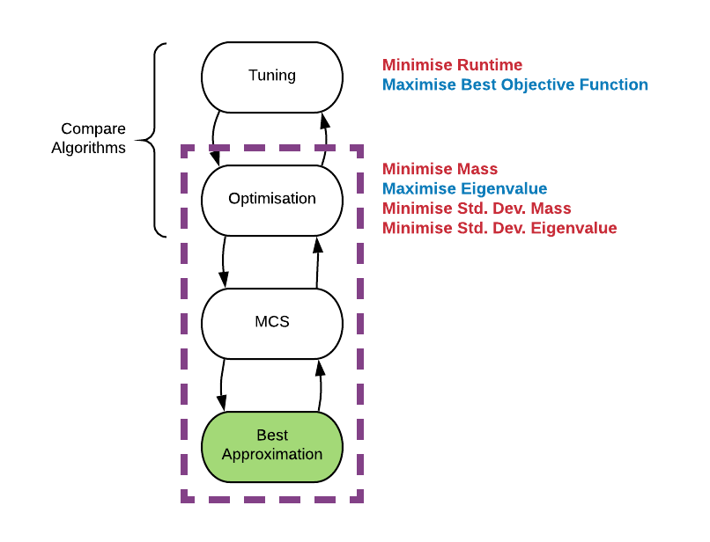
Tuning
Isight: Can’t manipulate optimisation parameters
Options:
Automate Isight
Run on separate script
Manual

Slide 8
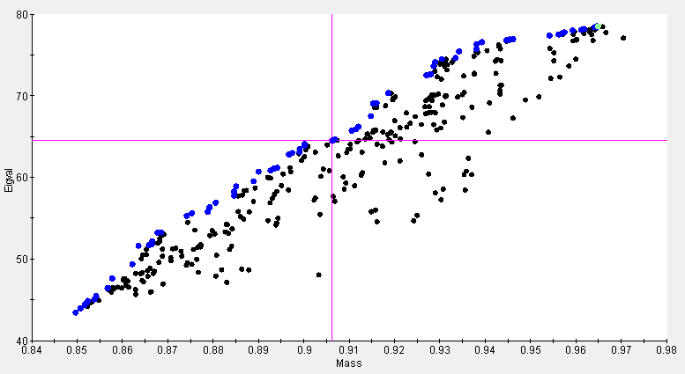
Optimal Pareto Set

Slide 9
Progress
Case 1: Plate with hole
Case 2: Deterministic mono-string
Case 3: Robust mono-string
Main Objectives
Final Report Work
Workflow set-up and learning
Program efficiency + validation
Results validation + analysis
Auxiliary Objectives
Wks 17-19
Wks 1-3
Wks 4-9
Wks 10-15
Week | 1 | 2 | 3 | 4 | 5 | 6 | 7 | 8 | 9 | 10 | 11 | 12 | 13 | 14 | 15 | 16 | 17 | 18 | 19
Month | Jan |  | Feb |  |  |  | Mar |  |  |  |  | Apr |  |  |  | May

Slide 10
Next Steps
Finish setting up robust design study
Compare results with deterministic
Mathematical walk-through for chosen 5 algorithms
Composite lay-up optimisation

Slide 11
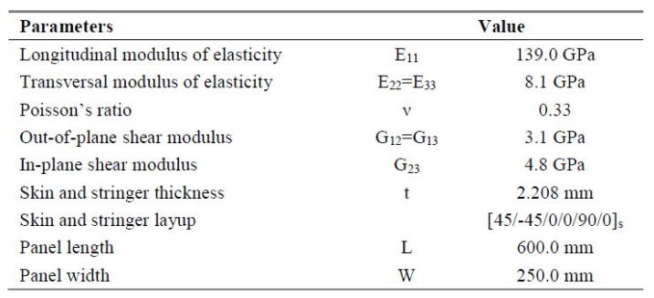
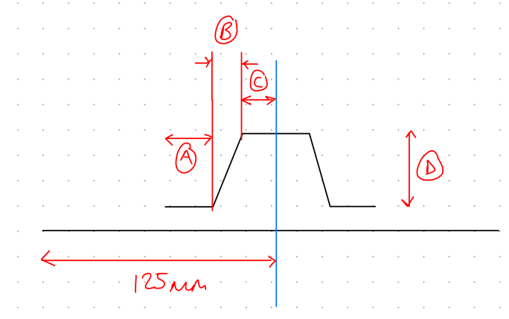
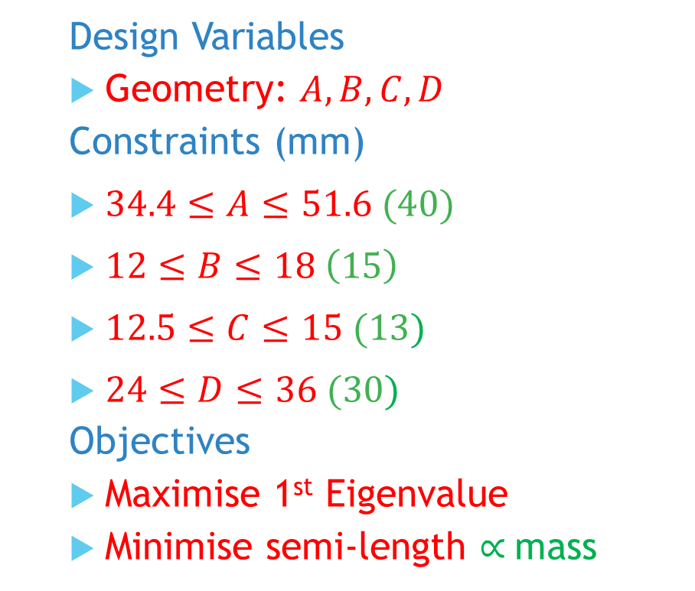
Mono-string: Problem
Design Variables
Geometry: $A,B,C,D$
Constraints (mm)
$34.4≤A≤51.6 (40)$
$12≤B≤18 \left(15\right)$
$12.5≤C≤15 (13)$
$24≤D≤36 (30)$
Objectives
Maximise 1st Eigenvalue
Minimise semi-length $∝$mass
Notes:
Post-buckling reliability design (vary lay-up)
Chapter 7: Robust Multilevel Design Optimization of Composite Panels
Robust and Reliability-Based Design Optimization of a Composite Floor Beam

